Slide 1
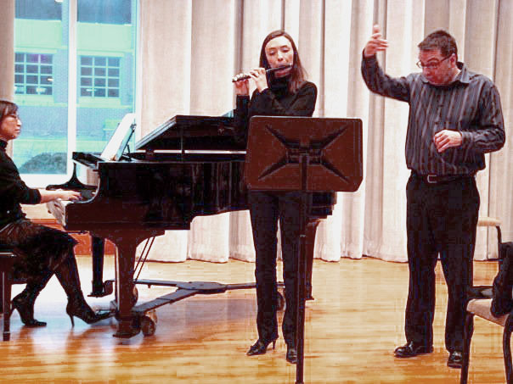
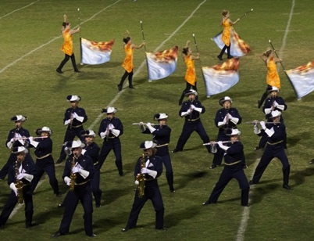
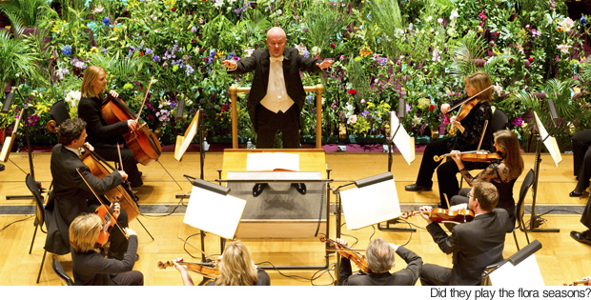
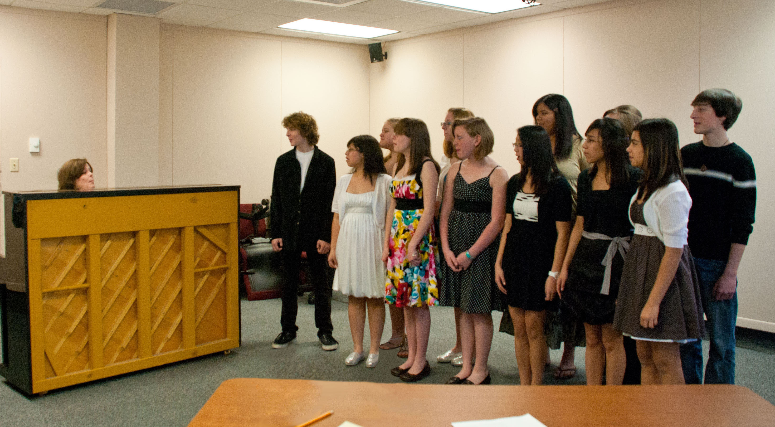
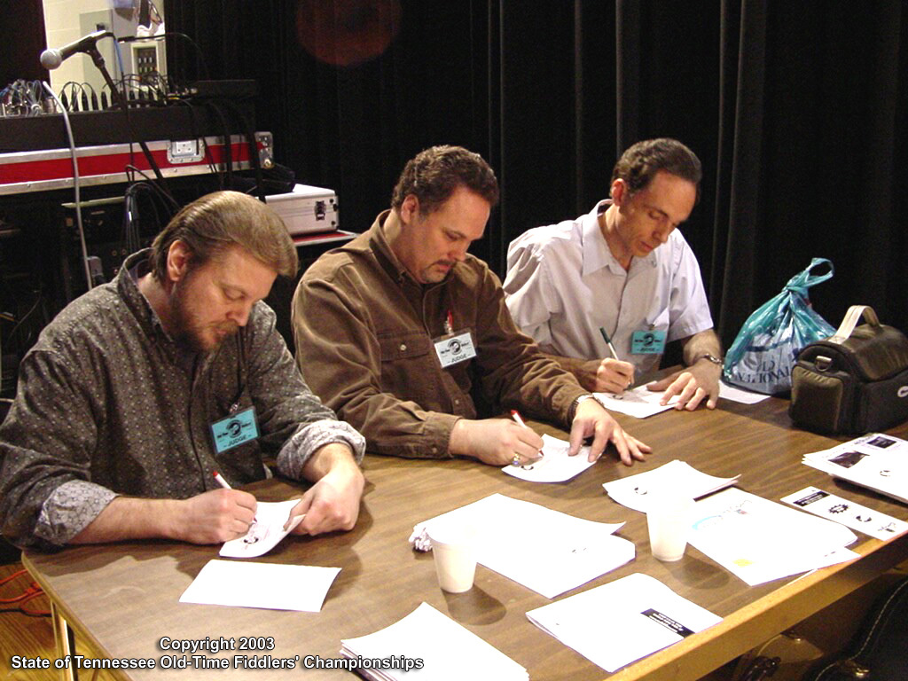
Competition in Music

Slide 2
Competition in Music
What is the role of competition in music class?
How do we know if/when we have reached a point where musicality, creativity and exploration have been diminished due to excessive competition
What steps can be taken to eliminate unnecessary competition from a music program?

Slide 3
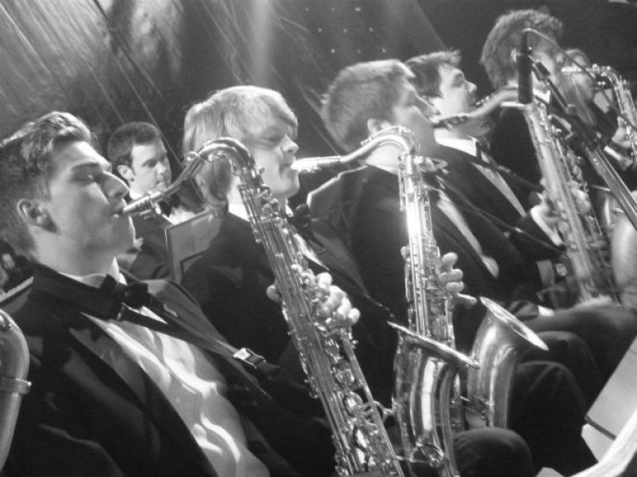
The Faces of Competition
Band, Orchestra and Choir festivals
District and State Solo & Ensemble
Concerto Competitions (or other non-school related individual competitions)
Chair Tests
Playing Tests
Going “down the line”

Slide 4
Why do we compete?
To set high standards
To push students, individually and collectively
To provide a visible product to measure success
To keep competition in check, the quality of student learning and motivation factors must be closely monitored.

Slide 5
Effects on Music Education
Extrinsic vs. Intrinsic
Does a program that thrives on competition promote a lifelong interest in the arts?
Competition promotes conformity
If the same rules apply to everyone, the game must be played the same way every time
Creativity and individualism are the opposite of competition because the very nature of creativity is to create something new that defies standardization.

Slide 6
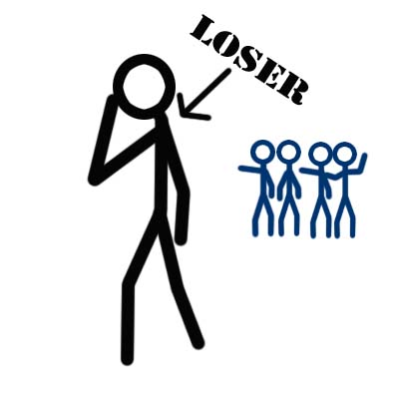
Is Music Education the Loser?
In order for one individual/group to succeed, another must not.
People with competitive goals withhold assistance, discouraging others.
Competition can be devastating to students who are low achievers.
Negative feedback and the experience of being at the bottom of a class can have long-lasting impacts.

Slide 7
Alternatives
A focus on competence, not competitive success
Develop a cooperative goal structure where students work together towards a common goal.
Emphasize long-term motivation and achievement among all students.
An alternative to Solo & Ensemble could be semester recitals.
Rotating seat plans

Slide 8
References
Austin, James R. “Competition: Is Music Education the Loser?” Music Educators Journal 76, no. 6 (February 1, 1990): 21–25.
Austin, James R. “Alternatives to Competition in Music Education.” The Education Digest 55, no. 9 (May 1990): 45.
Hurley, C. Gregory. “Musical Chairs: The Psychological and Social Impact of Competition.” Dialogue in Instrumental Music Education 20, no. 2 (Fall 1996): 74–87.
Miller, Rodney E. “A Dysfunctional Culture: Competition in Music.” Music Educators Journal 81, no. 3 (November 1, 1994): 29–33.
Sheldon, Deborah A. “The Effects of Competitive Versus Noncompetitive Performance Goals on Music Students’ Ratings of Band Performances.” Bulletin of the Council for Research in Music Education, no. 121 (July 1, 1994): 29–41.

