Slide 1
Michigan Teacher Certification
Introductions and Overview
Career Services
Standard Certification
Applying for the Standard Certificate
Other Kinds of MI Certification
Out of State Certification
Graduate Programs

Slide 2
Career Services
You are welcome to use career services resources in the College of Music and the College of Education
Christine Beamer, beamerch@msu.edu
Pepa Casselman, carls173@msu.edu
Appointments can be made on Handshake
For quick resume/cover letter reviews, send documents to COECareers@msu.edu

Slide 3
Use Handshake to Find Jobs
Handshake hosts hundreds of teaching positions each year!
Log in with student net ID and password at http://msu.joinhandshake.com

Slide 4
Destination Survey
Used to collect & share information about where Spartan Teachers are working.
Gives us a chance to reach out to those who are still looking – all results can be updated.
Takes less than 3 minutes to complete.
Survey link will be sent after graduation and will come from the College of Music. A follow up survey may come from the College of Education later in the summer.

Slide 5
Results from 2016-2017 Interns
Spartan teachers get hired!

Slide 6
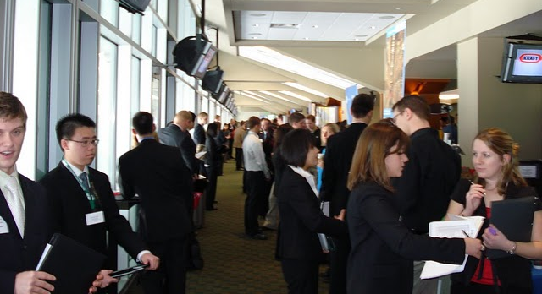
MSU Teacher Fair - 2020
Monday, April 20, 2020, 9:30 AM – 2:00 PM,
Breslin Center
For a list of school districts attending, log onto Handshake after the first of the year.

Slide 7
Certification Resource
Carey Ommen, Certification Specialist – commen@msu.edu

Slide 8
Standard Certificate
Initial teaching license/credential issued after successful completion of an approved teacher preparation program
Valid for up to 5 years during which the holder is expected to gain experience as a practicing teacher and continue professional development

Slide 9
Standard Certification Requirements
Bachelor’s degree conferred
Professional education and subject area coursework completed with minimum GPA of 2.5
Teacher preparation program completed, including internship
Basic skills test (MTTC PRE/ACT/SAT) and Music test (099) passed
World languages require oral proficiency demonstrated through a passing score on the ACTFL (if applicable)
Candidates must register for the ACTFL through LTI (Language Testing International)
Current CPR/First Aid certification at the time of recommendation
Completion of MDE Online Survey
Approval of Teacher Prep Institution

Slide 10
Applying for the Standard Certificate
Applying is a two-step process:
Submit materials required by MSU Certification Office in a single packet to 620 Farm Lane, Room 134 Erickson Hall, East Lansing, MI 48824
Initiate an application with the Michigan Dept. of Education (MDE) using the Michigan Online Educator Certification System (MOECS)
These two steps can be completed in either order or concurrently; however, both steps must be completed before the certificate can be issued.

Slide 11
Music Education Certificate is Secondary
You will be endorsed to teach Music Education in grades K-12.
This endorsement will go on a secondary teaching certificate.
If you have also completed an (optional) minor and passed the corresponding MTTC, you will be endorsed to teach that subject in grades 6-12. World languages also require oral proficiency demonstrated through a passing score on the ACTFL
You may choose to earn additional endorsements by completing the required coursework and passing the MTTC.

Slide 12
MSU Standard Certification Application
Do you anticipate a name change? (e.g. getting married?) Use your current name. You can change the last name on your certificate after you are married, but your paperwork must be completed in your current name.
Use your preferred non-MSU email address so you can be reached after completion of the internship. This is the email address that will be used to contact you if you are missing any documentation.
Standard CTE Certificate – only applicable if your major is Ag. Science. Otherwise, you will leave that item blank.
Fill in all majors and minors for which coursework has been completed, regardless if you passed the MTTC for that subject area or not.
Notes:
e

Slide 13
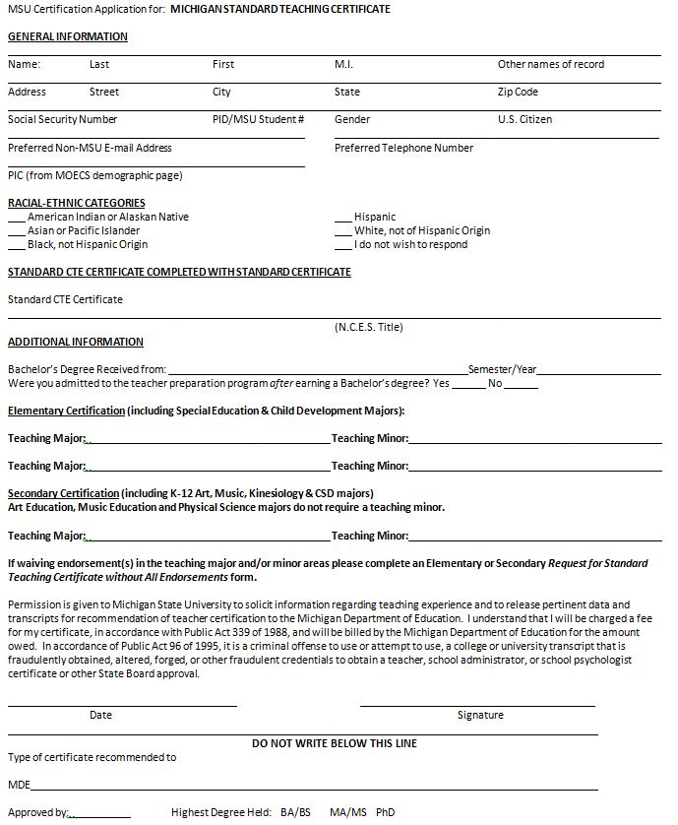
Please provide non-MSU email address.
Only Ag. Science interns will fill this area.
Elementary will fill in this section.
You will include ALL teaching majors and minors in which coursework is completed.
Secondary will fill in this section.
Don’t forget to sign and date.

Slide 14
Conviction Disclosure Form
Do you have a conviction and/or civil infraction that has already been reviewed by COE? Indicate the offense and date of conviction/civil infraction on the conviction disclosure form.
Do you have an arrest, pending charges, conviction or civil infraction that has not been reviewed by COE? Indicate the offense and date AND attach Register of Actions (ROA) or Judgment of Sentence (JOS) from the court in which you were convicted or admitted responsibility. Attach an explanation for why this was not previously disclosed.
Complete the form thoroughly, date and sign it (in ink)!

Slide 15
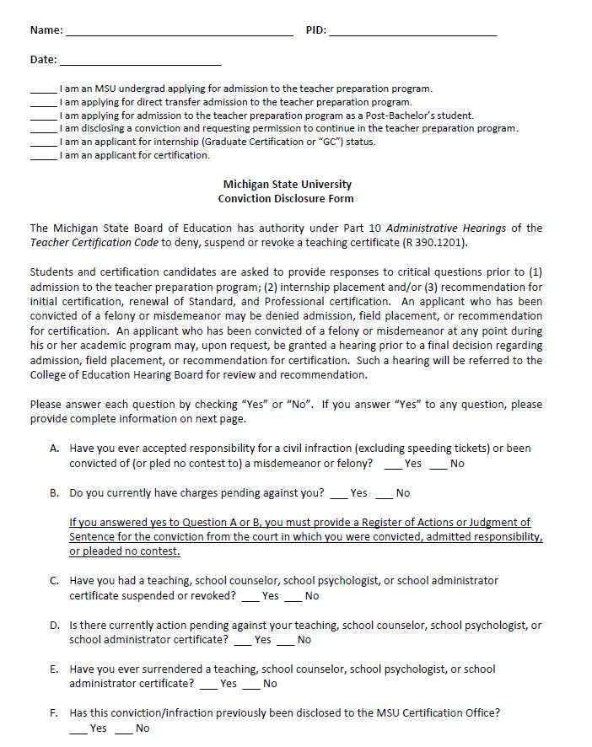
Please make sure to fill in name, PID, and date.
You are an applicant for certification.
You must answer ALL the questions.

Slide 16
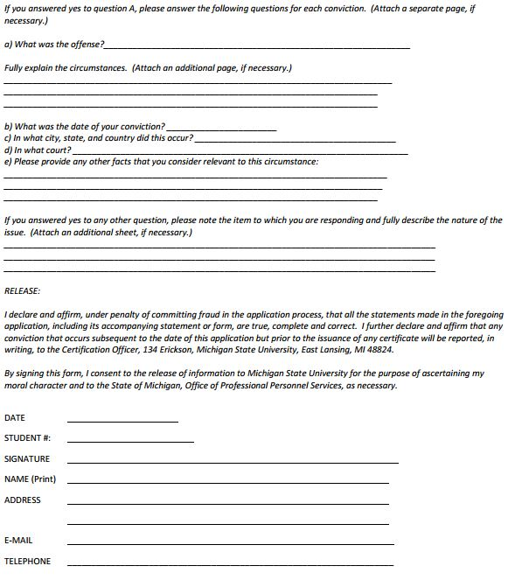
If you answered “yes” to any question on the previous page, you must complete this section.
Whether you answered “yes” or “no” to the questions on the previous page, you must still complete this portion.

Slide 17
Errors that Delay Certification (Please check before submitting your MSU application)
Did you fill out top portion of Conviction Disclosure Form (Name, Date, PID)?
Did you fully answer all questions on Conviction Disclosure Form?
Did you fill out the bottom of the 2nd page of the Conviction Disclosure Form?
Did you sign your Adult/Child CPR and First Aid card or Certificate?
Did you sign your MDE survey “thank you” page?

Slide 18
CPR/First Aid Certificate
American Heart Association, American Red Cross and other approved courses as listed on the MDE website - http://www.michigan.gov/documents/mde/Approved_First_Aid_and_CPR_Providers_397544_7.pdf
Must be certified in Adult and Child CPR and First Aid
Certification must be valid at the time you are recommended for teaching certificate by MSU
Make copies of the card OR certificate AFTER you sign it. Then attach to standard application.

Slide 19
MDE Online Survey
Link to online survey will be emailed to you by the Michigan Department of Education. (From: Dana Utterback <noreply@qemailserver.com>)with a Subject Line: Fall/Winter 2019Teacher Candidate Survey
Takes about 20 minutes to complete.
Only take the survey once!
Must print final (thank you) page and include it with your MSU application (Erickson Hall, 620 Farm Lane, Rm., 134, East Lansing, MI 48824), or your application WILL NOT be processed. Do not take the survey until you are connected to a printer. You cannot take the survey and print later. You must sign your printed “thank you” page.
Failure to complete the survey and print the last page will delay processing of your certificate.
MAKE COPIES - just in case you need to have another one to submit.

Slide 20
Upcoming Changes to Certification in Fall 2019
Secondary:
Minors or additional majors outside primary major subject area will require 1 credit* placement in the subject area (TE 409)
* Number of credit hours could change.
**If you waive a subject area which is impacted by the change and you have not added the endorsement prior to Fall 2019, you would be held to this new requirement in order to obtain the endorsement. This will also apply to any future endorsements.

Slide 21
Checklist for Standard Certificate Application
Materials required by MSU Certification Office:
Standard Certificate Application http://education.msu.edu/forms/certification/standard-application.pdf
Conviction Disclosure Form completed and signed (in ink)
Applicants with convictions/civil infractions must also submit ROA or letter from MSU Certification Officer
Verification of current MDE-approved adult/child CPR and First Aid certification
Applicants must sign both cards and provide copies of both sides of each card
Last page (thank you page) from online MDE Survey
Verification of name change (if applicable)
Elementary or Secondary Request for Standard Certificate without All Endorsements, if applicable

Slide 22
Applying for Standard Certificate through MOECS
Initiating a Certification Application Using MOECS
See instructions at http://www.michigan.gov/moecs or http://education.msu.edu/certification/moecs.asp
List only major/minor/endorsement areas for which courses are completed and MTTC (and ACTFL for languages) have been passed.
Applicants with a conviction/civil infraction, must answer “Yes” on MDE’s MOECS site.

Slide 23
Timeline for Application Process
Candidates submit single, complete application packet to MSU Certification Office and initiate online MOECS application
Online application is automatically routed to MSU Certification Office for review.
Final semester grades and degree conferral becomes available, MSU Certification Office begins to approve online applications electronically
MSU’s review cannot be completed until all required materials have been received from applicant and final semester grades are available. Bachelor’s degree must be conferred before recommendation can be made for the teaching certificate.
When MOECS application is approved by MSU, candidate is notified by MDE by email and prompted to pay online fee ($160).
Following payment, certificate is available and can be printed. MDE does not mail certificates.
When fee is paid online, certificate is available and can be printed. Must be notarized prior to employment in a school.

Slide 24
I’m Ready for a Job
Teacher Fairs, Applications, Interviews, etc.

Slide 25
Other MI Certifications
Professional Certification
Renewal of the Standard Certificate
Renewal of the Professional Certificate
Advanced Professional Teaching Certificate

Slide 26
Progressing to the Professional Certificate (Michigan’s second tier teaching license/credential)
Requirements for progressing to the Professional Certificate:
Three years of successful teaching since issuance of the initial Standard Certificate in the content area(s) and grade levels specified on the Standard Certificate
150 hours of education-related professional learning earned and entered into MOECS since issuance of the most recent certificate; options include:
Six semester credit hours at a college or university
150 SCECHS (State Continuing Education Clock Hours)
150 DPPD (District Provided Professional Development) hours, or
Some combination of #1-3 after issuance of most recent certificate OR
An education-related master’s or higher degree earned at any time (even if previously used to renew the Standard Certificate)
Completion of 6 semester credit hours of reading methods course work for elementary teachers and 3 semester credit hours for secondary certified teachers. (You met this requirement with TE 302).
Completion of an approved 3 credit course in reading diagnostics and remediation (TE 846 at MSU); this course can be counted toward the professional learning requirement if it was taken after issuance of the most recent certificate or renewal (it may also be applied toward some master’s degree programs)
Effectiveness ratings:
Consecutive: Effective or Highly Effective ratings on annual year-end performance evaluations for the three consecutive school years immediately preceding application for the Professional Certificate; or
Nonconsecutive: Effective or Highly Effective ratings on annual year-end performance evaluations for at least three nonconsecutive school years prior to applying for the Professional Certificate
Certificate is valid for 5 years; must be renewed every 5 years with unlimited renewals

Slide 27
Education-Related Professional Learning
Education-Related Professional Learning Hour Conversion:
College credit: 1 semester hour = 25 professional learning hours
SCECH hours: 1 SCECH hour = 1 professional learning hour
DPPD hours: 1 DPPD hour = 1 professional learning hour
TE 800 level coursework taken for initial (Standard) certification cannot be reused for Renewal of the Standard Certificate or to earn the Professional certificate, even if those credits are applied to a masters program.

Slide 28
Renewal of the Standard Certificate
If requirements for the Professional Certificate have not been met when the Standard Certificate expires, you may renew your Standard Certificate.
Valid for a period of 5 years with unlimited renewals
All certificates expire 5 years from June 30 of the calendar year in which the certificate was issued.
Renewal requires 150 hours of education-related professional learning earned and entered into MOECS since issuance of the most recent certificate; options include:
Six semester credit hours at a college or university
150 SCECHS (State Continuing Education Clock Hours)
150 DPPD (District Provided Professional Development) hours, or
Some combination of #1-3 after issuance of most recent certificate OR
An education-related master’s or higher degree earned at any time (may be used one time to renew the Standard Certificate)
TE 800 level coursework taken for initial (Standard) certification cannot be reused for Renewal of the Standard Certificate or to earn the Professional certificate, even if these credits are applied to a masters program.

Slide 29
Renewal of Professional Certificate
Valid for a period of 5 years with unlimited renewals
All Professional Certificate renewals expire 5 years from June 30 of the calendar year in which they were issued.
Renewal requires 150 hours of education-related professional learning earned and entered into MOECS since issuance of the most recent certificate; options include:
Six semester credit hours at a college or university
150 SCECHS (State Continuing Education Clock Hours)
150 DPPD (District Provided Professional Development) hours, or
Some combination of those after issuance of most recent certificate

Slide 30
Reference
For complete and current certification information, see the MDE (Michigan Department of Education) website:
http://www.michigan.gov/mde/0,4615,7-140-5683_14795_83462---,00.html

Slide 31
Out of State Certification
Need valid certificate from Michigan
May obtain temporary authorization or provisional certificate to teach in another state initially while additional requirements are completed
Keep info about your pre-internship and internship experiences (e.g., where you taught, grade levels/subjects, etc.). If institutional form requires this info, send with your request (do not fill it in on form).
It’s possible that another state may have questions about your preparation in one or more areas. If a letter addressing a perceived deficiency is required, you will need to provide the Department of Education for that state the syllabi for the course(s) in which you believe the relevant material was covered and provide a rationale. Keep your syllabi, as a few states require a syllabus from the specific course/year/semester/section taken by the candidate.

Slide 32
Out of State Certifications (cont.)
Likely to need institutional recommendation form verifying completion of approved teacher preparation program signed by our Certification Officer (Erickson Hall, 620 Farm Lane, Rm., 134, East Lansing, MI 48824)
If you know that you will be applying for certification in another state, please include out-of-state forms with your application for the provisional certificate submitted to the MSU Certification Office.
Be sure to check with the State Board/Department of Education for the particular state in which you are seeking certification for a detailed list of requirements, the application for certification in that state, and any questions you may have. They are the experts on that state’s requirements.
Helpful website: www.certificationmap.com

Slide 33
Illinois Certification (as example)
For Illinois, see: https://www.isbe.net/Pages/Educator-Licensure-Requirements.aspx
Expect to take additional certifying exams
Expect to take an additional course(s) during initial year of teaching

Slide 34
Graduate Programs
Check out prospective graduate programs via internet or publications
Determine deadlines and requirements
Apply early – some programs have enrollment limitations and DO FILL UP.
Graduate Programs at MSU have 5 year completion limitation

Slide 35
Graduate Programs (cont.)
Master’s Programs in College of Education: http://education.msu.edu/academics/masters/
MA in Teaching and Curriculum/MATC: can earn K-12 ESL or K-12 Reading Specialist (those with ESL minors can extend to K-12 ESL)
MA in Special Education: can add endorsements in K-12 Learning Disabilities or K-12 Autism
MA in Educational Administration: can earn K-12 School Administrator Certificate
MA in Educational Technology: can earn Educational Technology endorsement or gain valuable background
Masters in Education (MAED), includes various concentrations (no endorsements at this time)

Slide 36
MSU Resources
MSU College of Education Home Page: http://www.education.msu.edu (click on the Certification banner)
Information about Applying for the Standard Certificate: Under Certification, click on MSU Interns: http://www.educ.msu.edu/certification/intern/
Certification Guidance from the Michigan Department of Education: http://www.michigan.gov/mde/0,4615,7-140-5683_14795_83462---,00.html
MDE FAQs about Certification: http://www.michigan.gov/mde/0,4615,7-140-5683_57223-247108--,00.html
MSU College of Education Alumni Association: http://education.msu.edu/alumni/

